Slide 1
SFP Demo Configuration Handbook WxCC 2.0
CCBU Solution Assurance
Document version 1.0
30-10-2020

Slide 2
What is this about ?
What is this Not about ?
Anyone with a WxCC 2.0 tenant access should be able to configure it to demonstrate the capabilities of this platform in their own demo/Gold tenants.
This handbook will be shared internally first (TME, TSA, Sales, Mktg) and eventually to partners in EFT
This is a ‘living document’, more capabilities will be added as they become available
This helps provide a consistent demo experience
Training/Deep dive session
Step by Step demo guide/story with speaker notes (Will be a separate effort)

Slide 3
Overall Pre-Requisites / Assumptions
1 | Steps in this guide are based on and for configuring a tenant in production environment
2 | Users of this guide already have administrator access to a production tenant
3 | Voice connectivity is available on the production tenant
4 | DN to EP mapping is done with a working DN
5 | Users of this guide already have Email ID for email contact routing
6 | Users of this guide already have a SMS Number procured from MessageBird, that can be integrated with the tenant.
7 | Users of this guide already have a Facebook page which can be integrated with the tenant
8 | Users of this guide already have a Google CCAI account that can be configured in the tenant
9 | Tenant has Feature Flags enabled for desktop layout, Chat/Email, Virtual Assistant, Social, FlowControl
10 | All config entities are created with prefix MediAssist For example: Site: MediAssist_Site, Team: MediAssist_Team, EP: MediAssist_Voice_EP

Slide 4
Config Handbook - Who & Where ?
Module-1 | User Onboarding | Ankit
Module-2 | Chat | Abhishek
Module-3 | Email | Naveen
Module-4 | Social | Chandra
Module-5 | Voice | Avinash
Module-6 | WxM Post Call Survey | Raghu
Module-7 | External DB Dips | Chandramouli
Module-8 | Agent Desktop(KAD) | Sameer
 | Support/Facilitator | Gagarin
 | Reviewers/Mentors | Karthik/Mudit
Environment | ProdUS1 (WxCC US DC)
Org | Webex CC Demo 101
Org ID | 12700722-cd25-46b9-971e-ed0ce9f140c6
Access | <cec>@email.carehybrid.com
Control Hub | https://admin.webex.com
Portal | https://portal.wxcc-us1.cisco.com/portal/home.html
Agent Desktop | https://desktop.wxcc-us1.cisco.com
Main IVR | 516-517-9009
Sample API for Ext. DB Dip | https://5f9a64f59d94640016f709bf.mockapi.io/api/customers/account

Slide 5
Objective: This lab is designed to ensure we onboard various user personas in to WxCC.
As part of this guide, we will cover following steps:
Important: Let's use a naming convention in order to help us maintain this tenant. Please use the format from below. Most important, always lead with your username.
Voice Configuration:
Create EP = <username>_voice_EP ie: (ntheolog_voice_entrypoint)
Map DiD to your EntryPoint.
Create your Team = <username>_team
Create Q = <username>_voice_Q
Create EP Routing Strategies = <username>_RS_voice_EP
Create Q Routing Strategies = <username>_RS_voice_Q
Associate Teams to respective Q

Slide 6
Module 6
Extensible Agent Desktop

Slide 7
Objective: Demonstrate the new extensible agent desktop with customized widgets
Pre-Requisites/Assumptions
Outcome
Administrator/ Supervisor with portal access
New user (Agent) is already created
Agent is able to login to agent desktop
Agent should be part of a team
Basic knowledge of JSON format
Use any online JSON validator( https://jsonlint.com/ ) to validate the file
Able to use the readily available customized desktop layout in your demo
Able to create your own desktop layouts for demos or other use cases
After agent login, all customized widgets are accessible

Slide 8
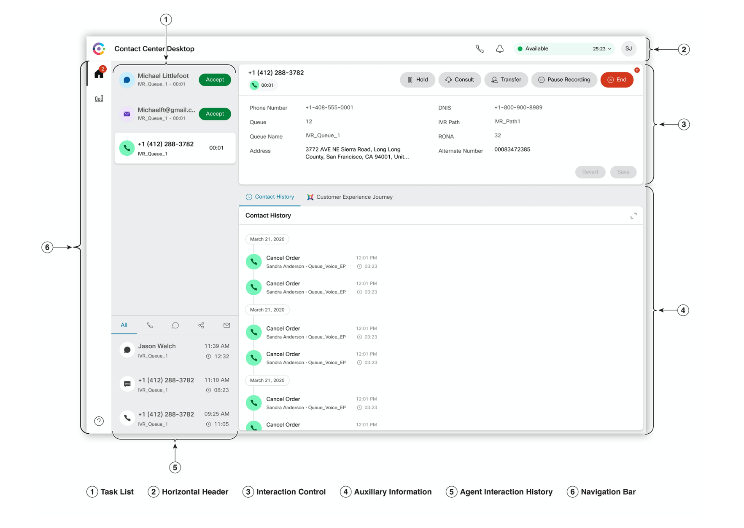
Agent Desktop Layout Overview and Customizable Areas
You can customize the Agent Desktop for the following features using the JSON file:
Title — Title of the Agent Desktop application that appears on the horizontal header.
Logo — Logo of the Agent Desktop application that appears on the horizontal header.
Drag-and-Drop and Resize — The feature enables custom pages and widgets to move and resize.
Notification timer — The feature is used to set the timer for a notification to display on the Agent Desktop. The notification appears near the Agent Status drop-down list.
Custom pages and widgets — This feature enables you to create custom pages and widgets that appears on the auxiliary pane.

Slide 9
Exercise 1 : Assign logo and title to WebEx Contact Centre Agent Desktop

Slide 10

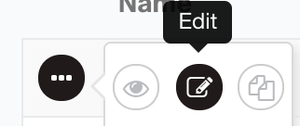
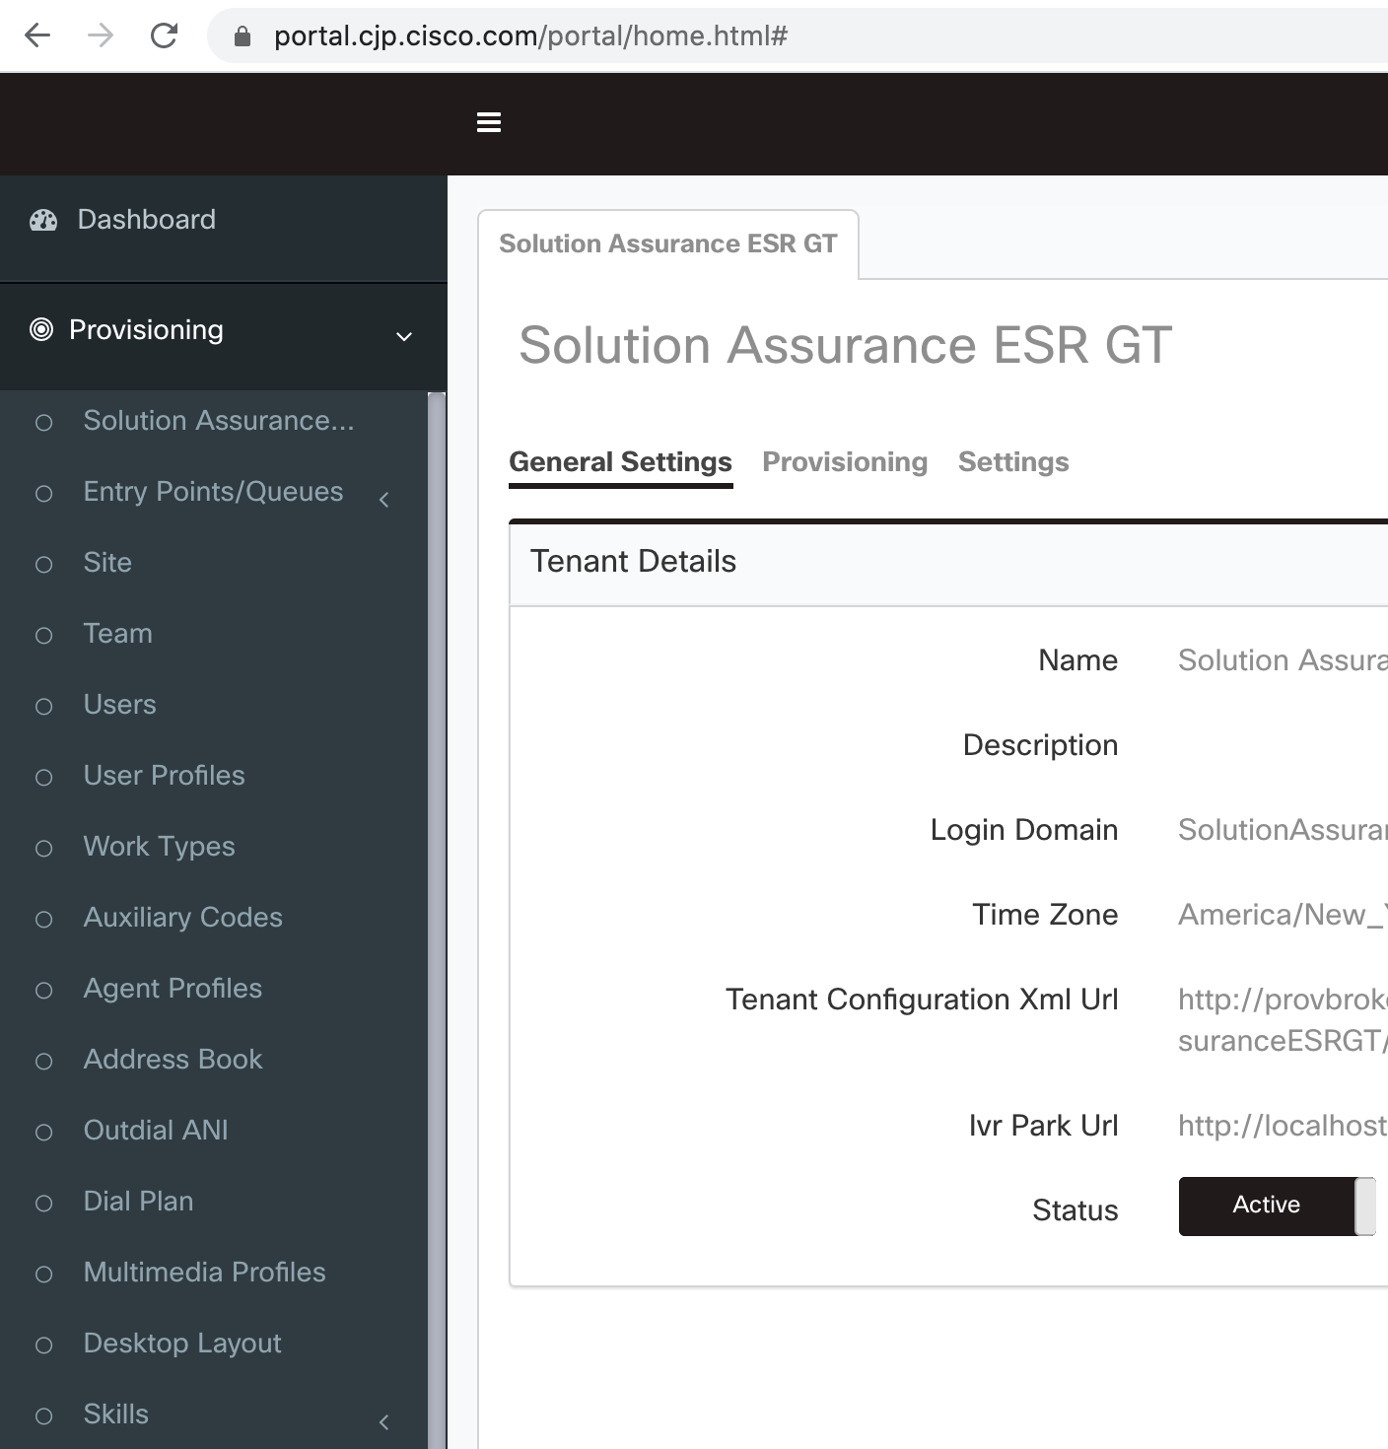
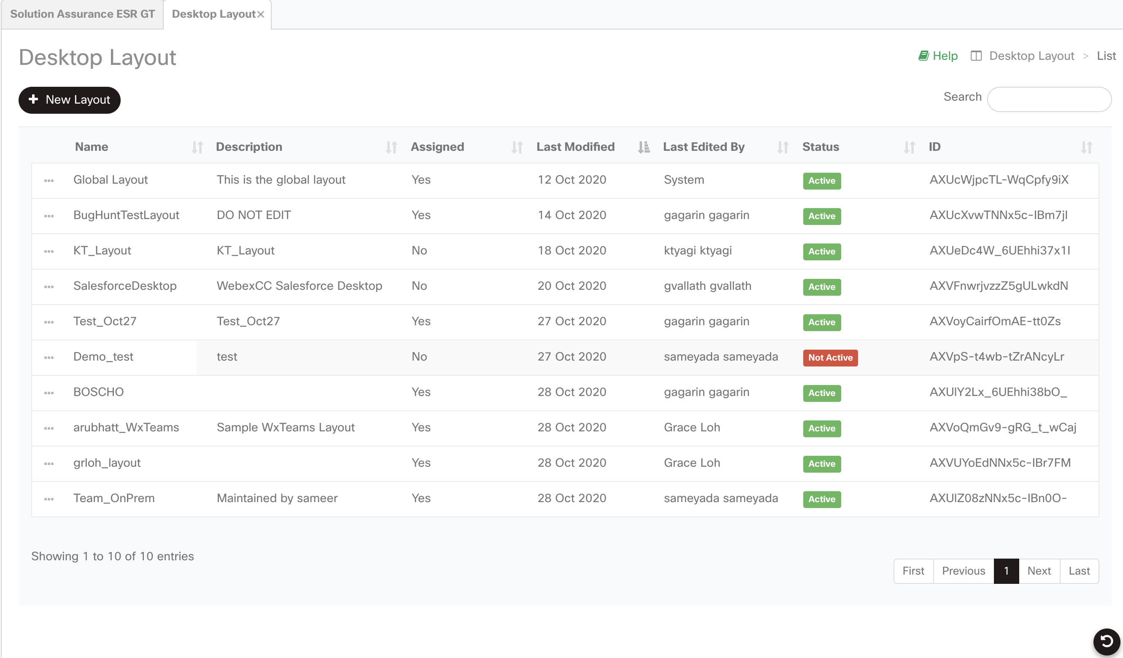
Step1
Login to portal (https://portal.wxcc-us1.cisco.com) with administrator credentials
Navigate to Provisioning → Desktop Layout
Click on of Global Layout to edit (you are not really editing.. Just going in to download the default layout)
Now click on edit
1
2

Slide 11

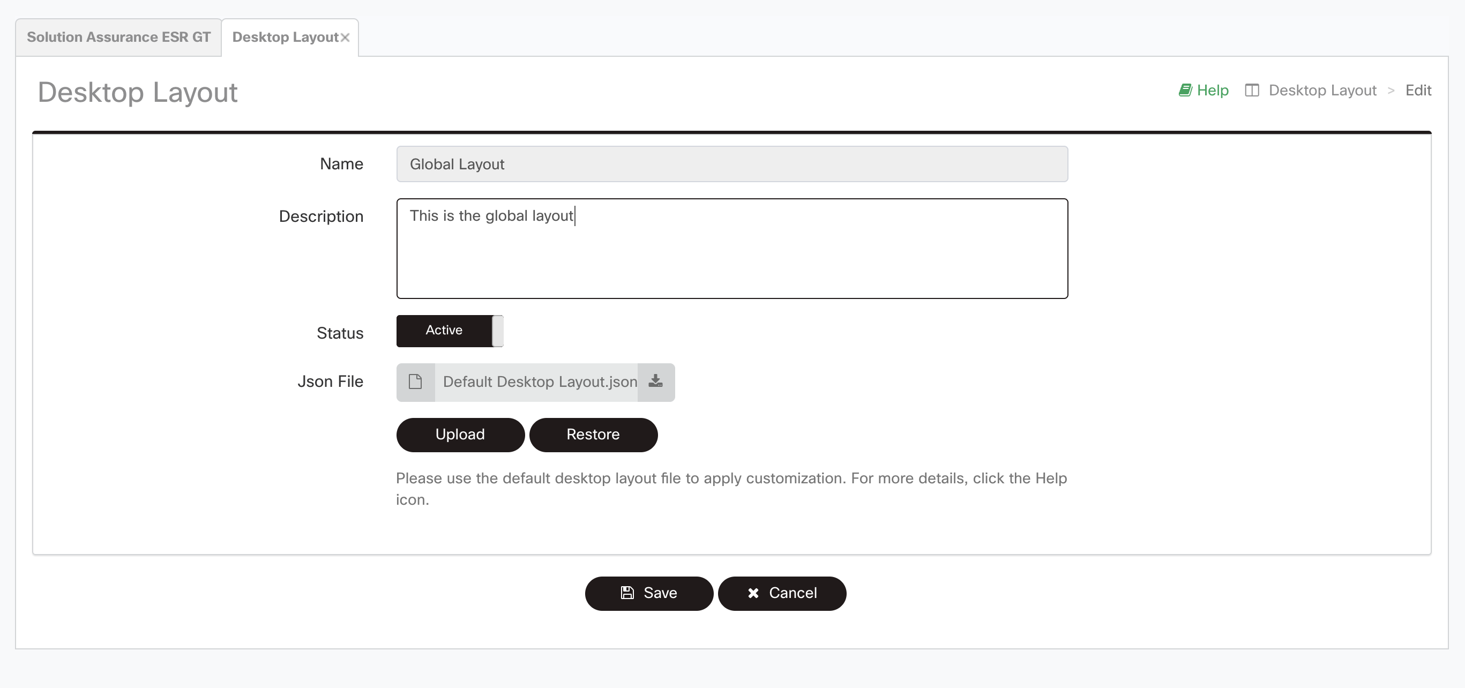
Step 2
Click on download button
Download the Default Desktop Layout.json file
Now cancel out, as you only need to get the JSON file.

Slide 12
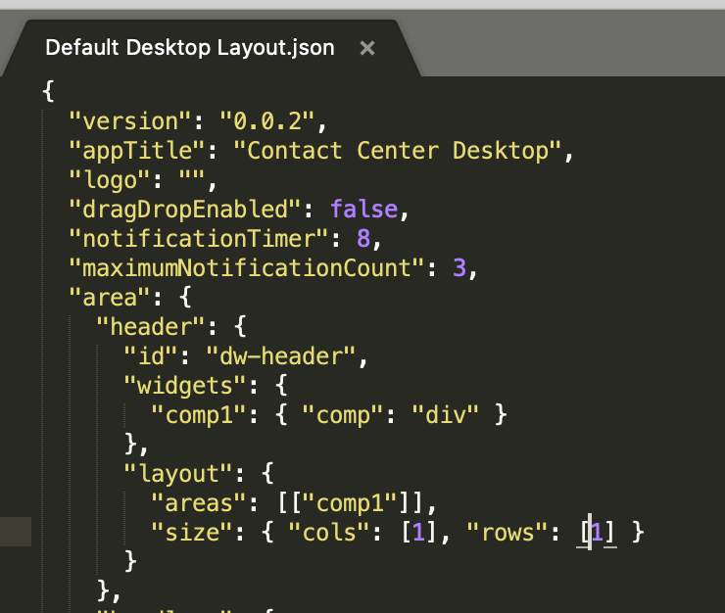
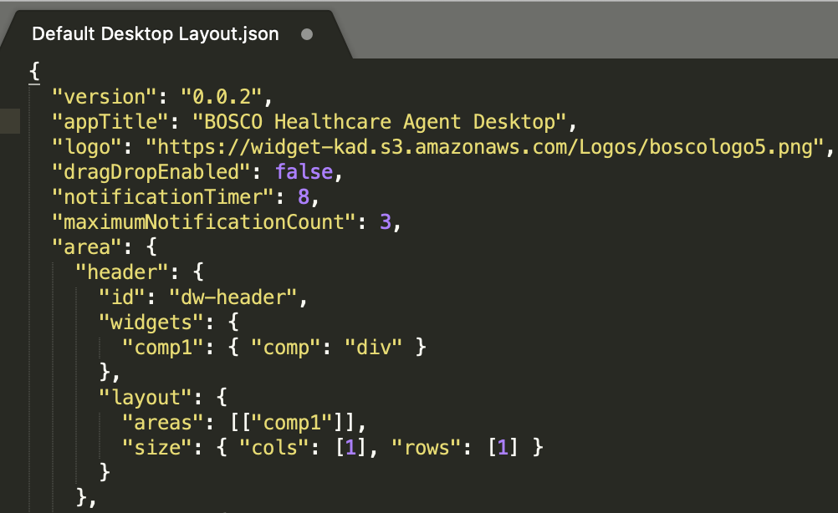

Default Layout
Step 3
Open the Default Layout JSON in any text editor e.g. Notepad or Sublime text.
Modify the value of appTitle key to change Agent Desktop title (Refer Pic-1).
Modify the value of logo key as your company logo URL or use this dummy url https://widget-kad.s3.amazonaws.com/Logos/boscologo5.png (Refer Pic-2)
“Save As” the JSON file with a distinguishable name.
1
Modified Layout
2

Slide 13

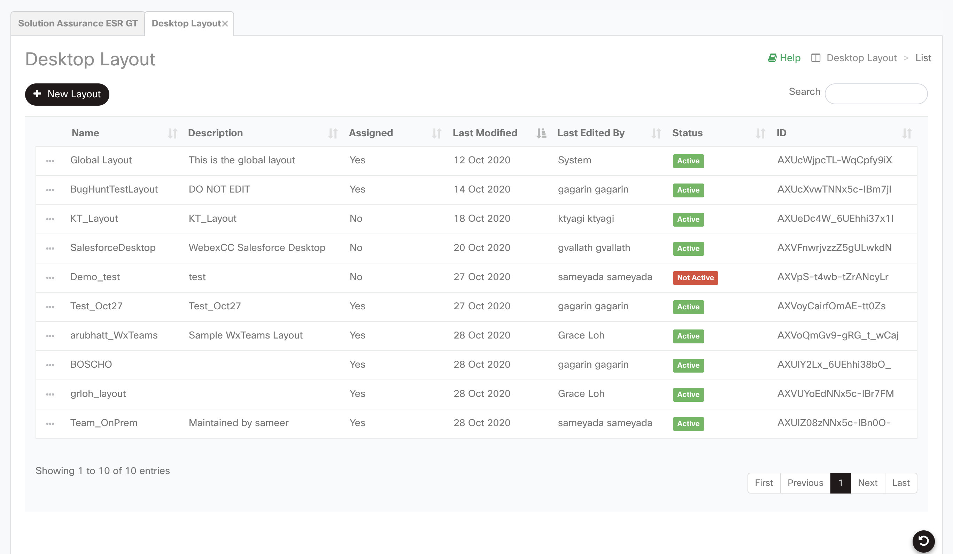
Step 4
Login to portal : https://portal.wxcc-us1.cisco.com/portal/home.html with administrator credentials
Navigate to Provisioning → Desktop Layout
Click on

Slide 14

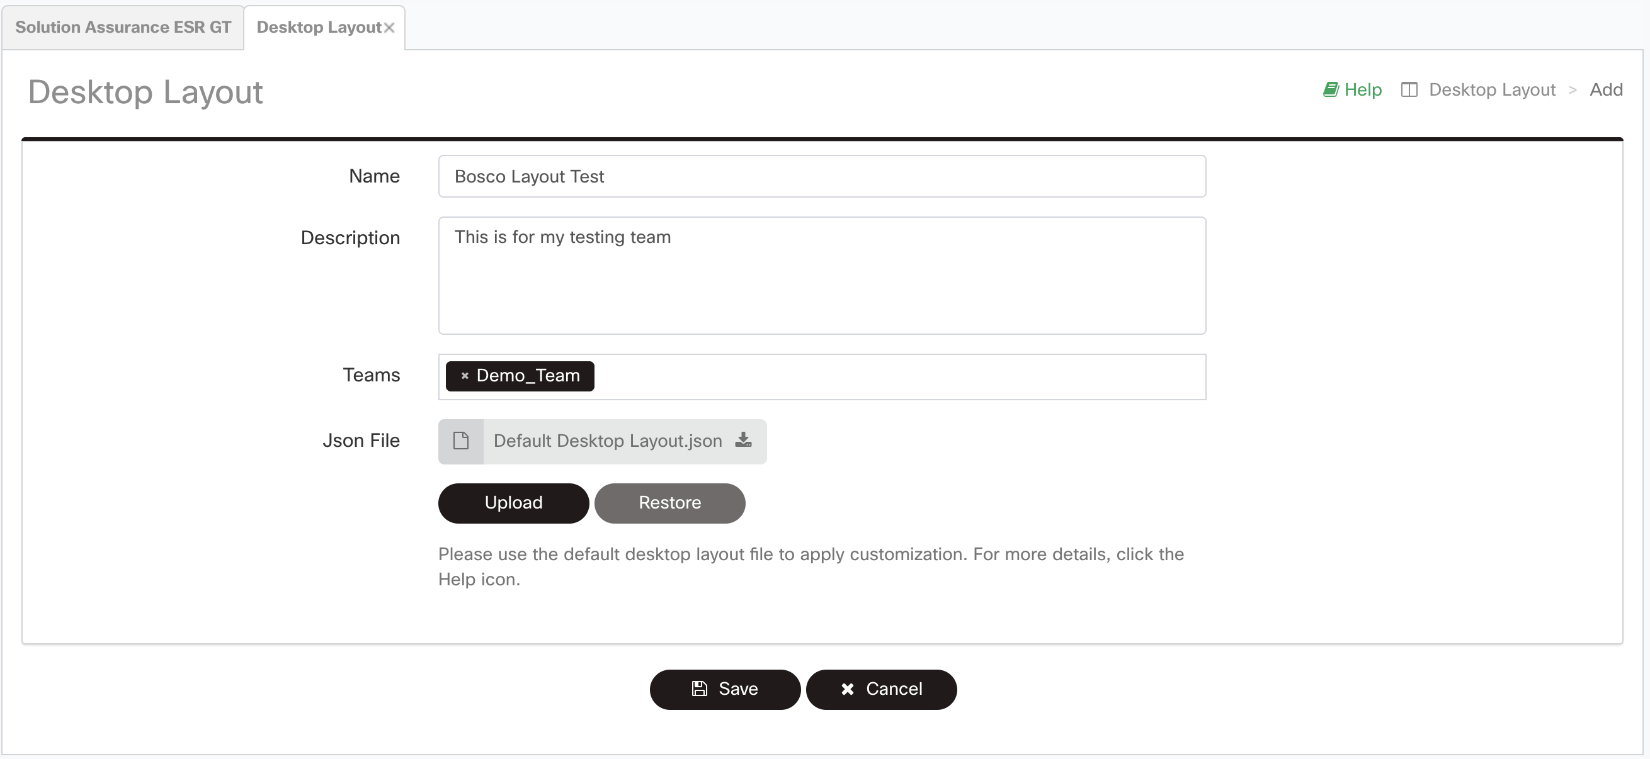
Step 5
Provide any preferable name and description ie <username>_team_layout
Click on Team textbox to add the team
Click Upload button to upload the modified JSON file
Click Save button to apply the layout.
TIP: If you are facing validation error during upload then please validate your json first with online json validator

Slide 15
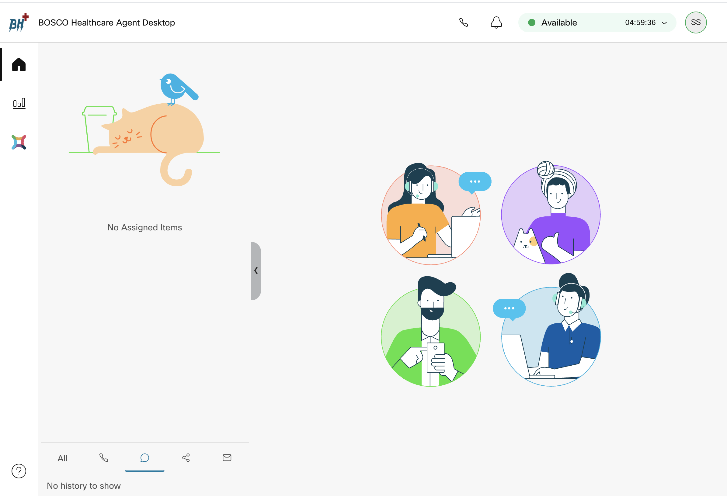
Step 6
Login/Reload agent desktop to verify the layout (https://desktop.wxcc-us1.cisco.com)

Slide 16
Exercise 2 : Assign header widget and navigation bar widget
Pre-Work : Login to portal and download the Default Desktop Layout JSON or use existing custom layout JSON (Refer Exercise1)

Slide 17
Step 1
Open the layout JSON file in any text editor e.g. Notepad or Sublime text.(be careful copying from PowerPoint might add unwanted spaces/characters... causing the JSON to fail on load) use an online JSON formatter like https://jsonformatter.org/ to clean up if need be.
Modify the header section as mentioned below
Modified Inside the: "area": {
object
Use your own widget URL here
Default
"header": {
"id": "dw-header",
"widgets": {
"head1": {
"comp": "agentx-wc-iframe",
"style": {
"height": "64px",
"width": "520px",
"display": "inline-block",
"align-items": "center"
},
"attributes": {
"src": "https://widget-kad.s3.amazonaws.com/Headers/Timer.htm"
}
}
},
"layout": {
"areas": [["head1"]],
"size": { "cols": [1], "rows": [1] }
}
},
"header": {
"id": "dw-header",
"widgets": {
"comp1": { "comp": "div" }
},
"layout": {
"areas": [["comp1"]],
"size": { "cols": [1], "rows": [1] }
}
},
Copy paste this

Slide 18
Step 2
Modify the navigation section as mentioned below
“Save As” the JSON file with a unique preferable name.
Modified
Default
"navigation": [
{
"nav": {
"label": "COVID Statistics",
"icon": "https://widget-kad.s3.amazonaws.com/Logos/covid1.png","iconType": "other" , "navigateTo": "covid","align": "top" },
"page": {
"id": "covid",
"widgets": {
"right": {
"comp": "agentx-wc-iframe",
"attributes": { "src" : "https://widget-kad.s3.amazonaws.com/iframe/covid-chart.html" } ,
"wrapper": { "title" : "COVID Global Chart" , "maximizeAreaName": "app-maximize-area" }
}
},
"layout": { "areas": [ ["right"] ], "size": { "cols": [1],"rows": [1] }}}},
{"nav": {
"label": "WebEx Experience Manager Metrics",
"icon": "/app/images/wxm.bcd45cc3.svg",
"iconType": "other",
"navigateTo": "wxm-metrics",
"align": "top"
},
"page": {
"id": "wxm-metrics",
"widgets": {
"comp1": {
"comp": "agentx-wc-cloudcherry-widget",
"attributes": { "metrics": true },
"properties": {"userModel": "$STORE.app.userModel","spaceId": "$STORE.app.wxmUserParams.spaceId",
"metricsId": "$STORE.app.wxmUserParams.metricId","teamId": "$STORE.agent.teamName"
}}},
"layout": { "areas": [["comp1"]],"size": { "cols": [1], "rows": [1] }
}}
}
]
"navigation": [
{
"nav": {
"label": "WebEx Experience Manager Metrics",
"icon": "/app/images/wxm.bcd45cc3.svg",
"iconType": "other",
"navigateTo": "wxm-metrics",
"align": "top"
},
"page": {
"id": "wxm-metrics",
"widgets": {
"comp1": {
"comp": "agentx-wc-cloudcherry-widget",
"attributes": {"metrics": true},
"properties": {
"userModel": "$STORE.app.userModel",
"spaceId": "$STORE.app.wxmUserParams.spaceId",
"metricsId": "$STORE.app.wxmUserParams.metricId",
"teamId": "$STORE.agent.teamName"
}}},
"layout": {
"areas": [["comp1"]],
"size": {"cols": [1],"rows": [1]
}}}}
]
Copy paste this

Slide 19
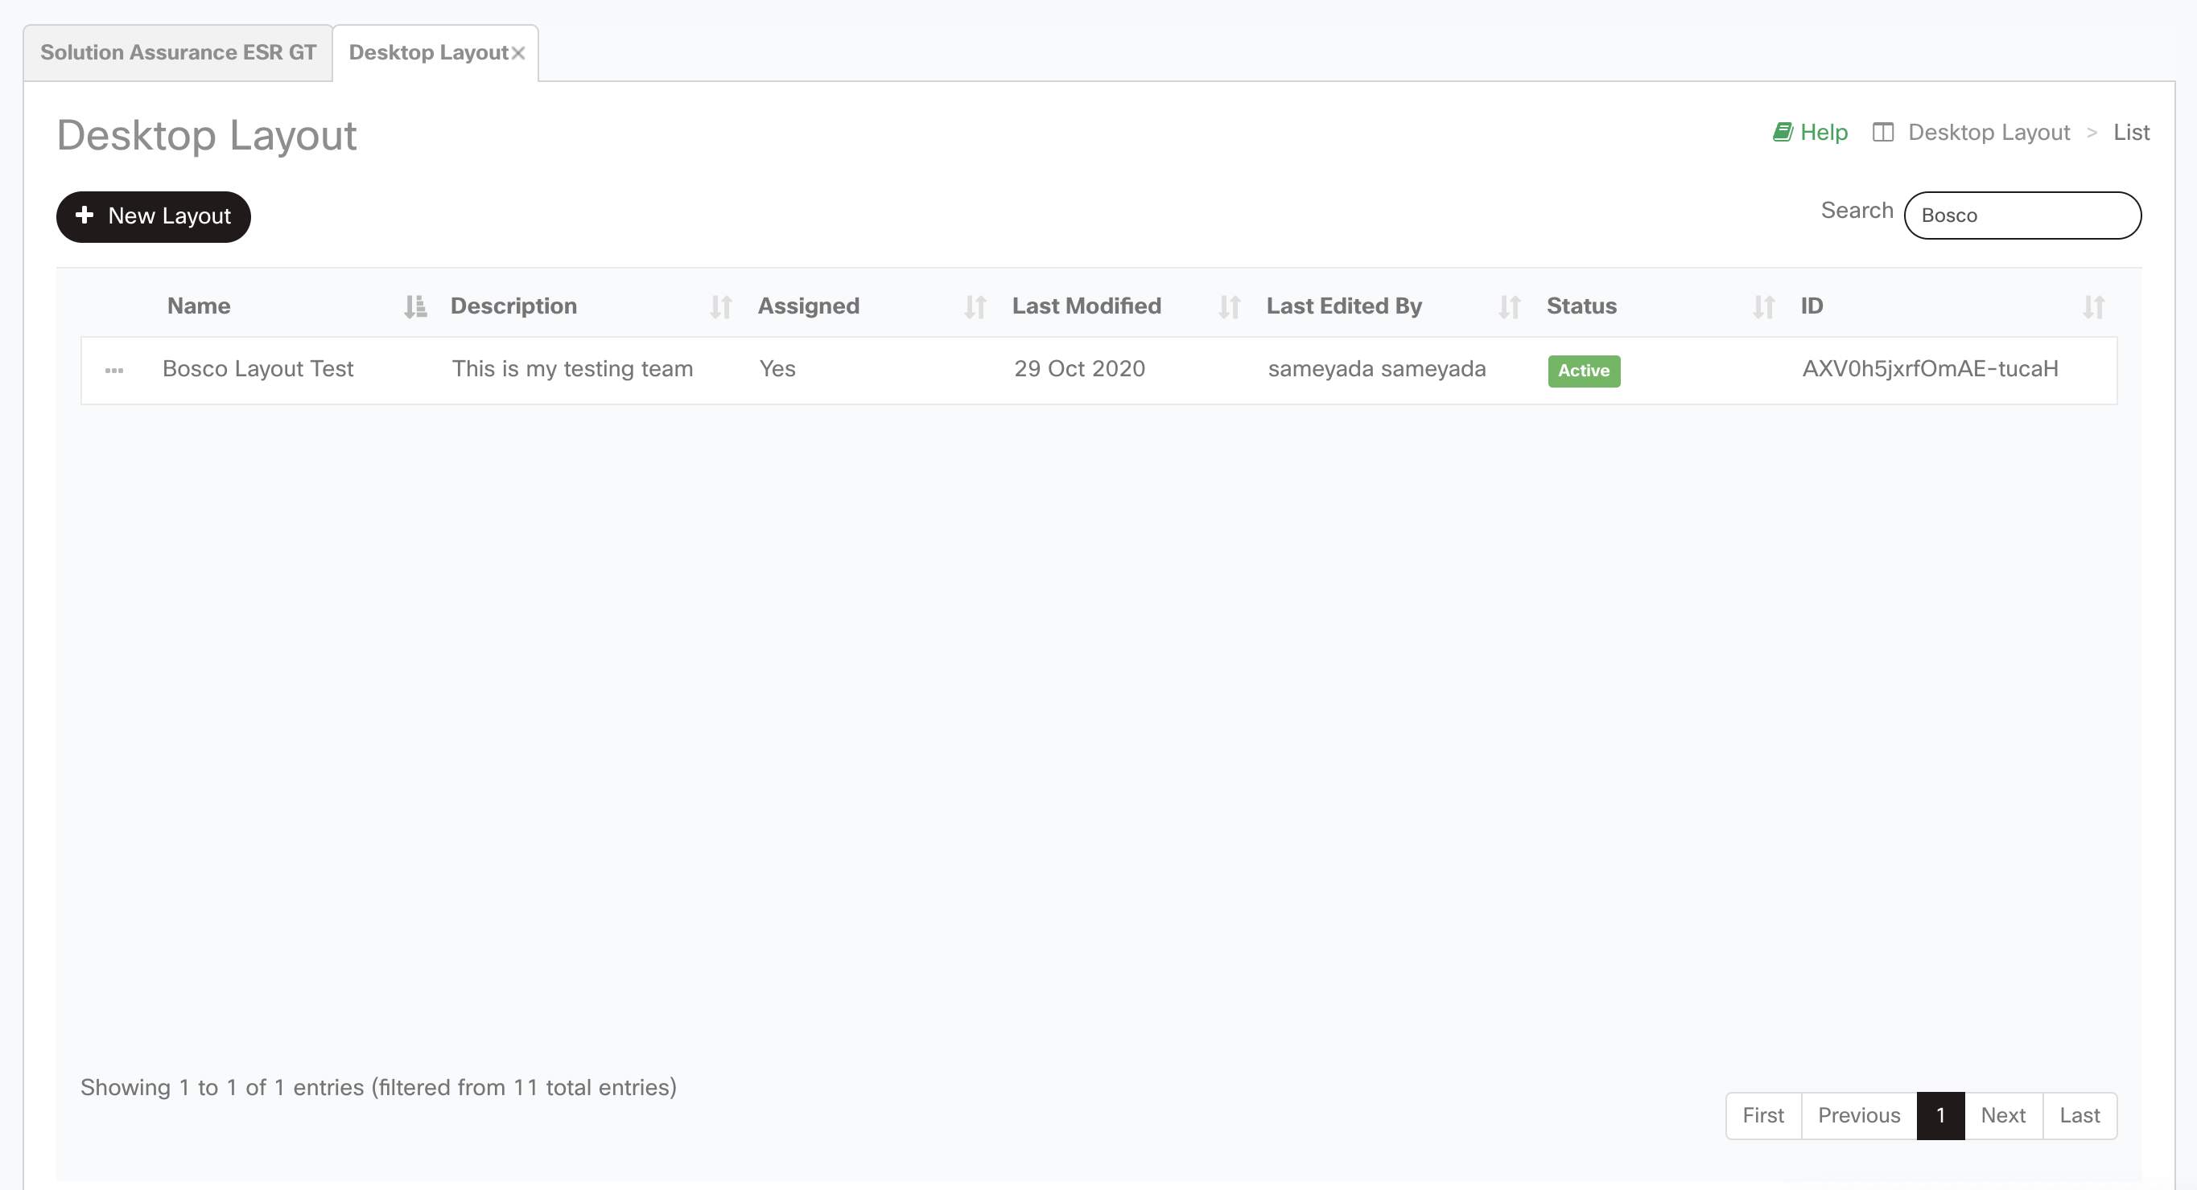
Step 3
Login to portal : https://portal.cjp.cisco.com/portal/home.html with admin credentials
Navigate to Provisioning → Desktop Layout
Search for your layout
Click on to edit the existing layout
Now click on edit

Slide 20
Step 4
Click Upload button to upload the modified JSON file
Finally click Save button to apply the layout.
TIP: If you are facing validation error during upload then please validate your json first with online json validator

Slide 21
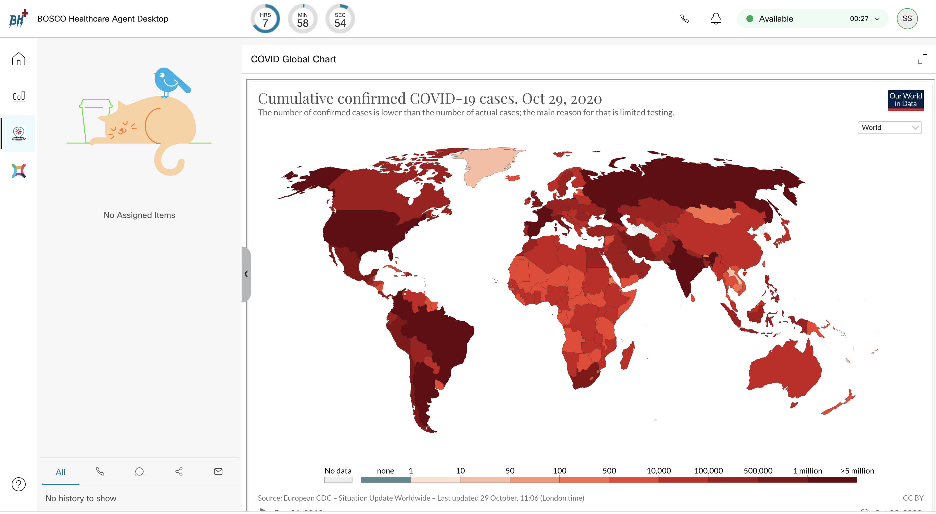
Step 4
Login/Reload agent desktop to verify the layout (https://desktop.wxcc-us1.cisco.com)

Slide 22
Summary:
On the agent desktop we should be able to see custom logo , header, header widget and navigation bar widget
Verify Below points:
Login to WxCC Agent Desktop (https://desktop.wxcc-us1.cisco.com)
Make sure team assigned to agent and desktop layout are same
Use online json validator to verify the json formatting such as https://jsonlint.com/

